Slide 1
The South London Experiment

Slide 2
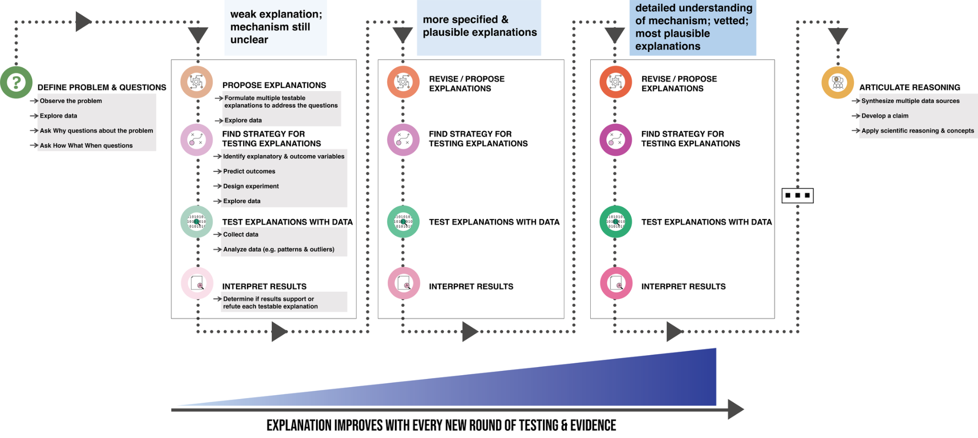
Data Science Reasoning Framework

Slide 3
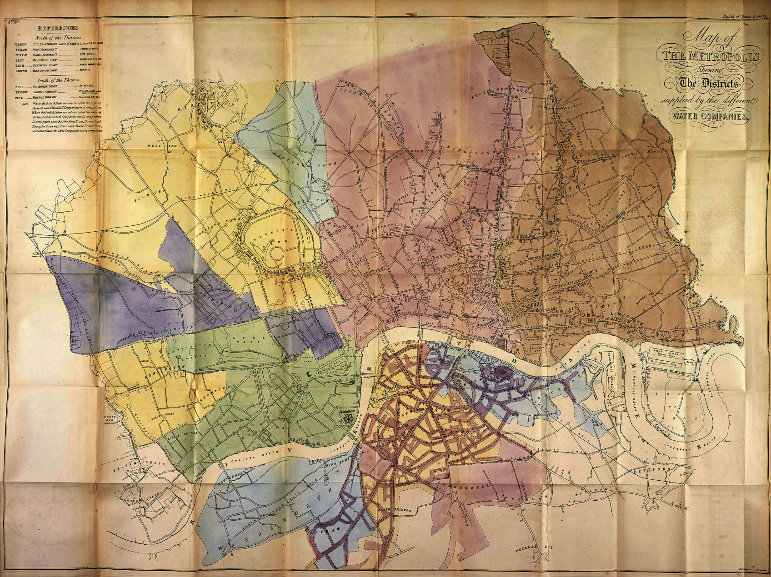
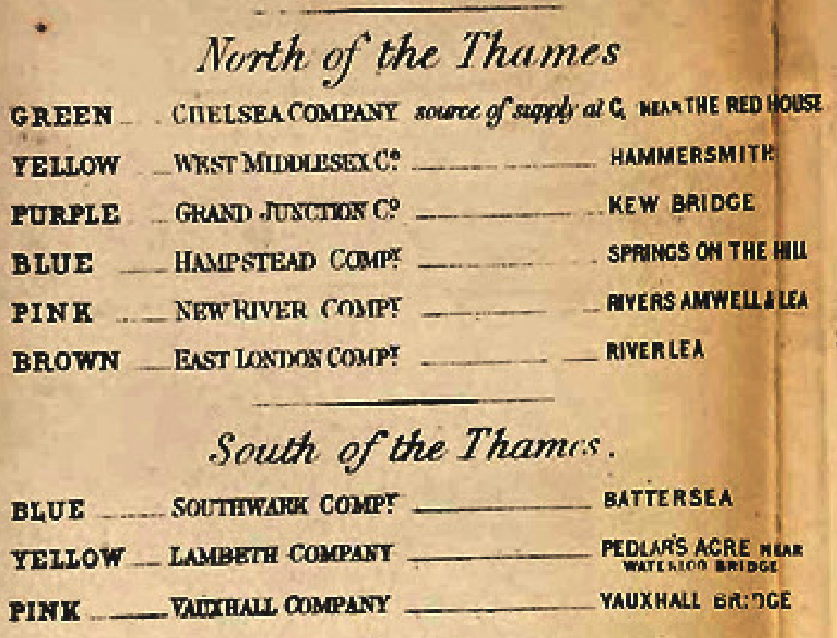
London Water
Suppliers

Slide 4
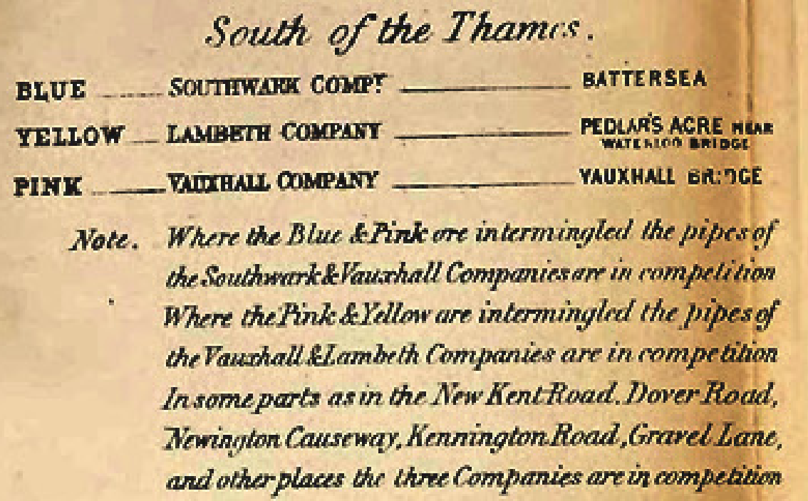
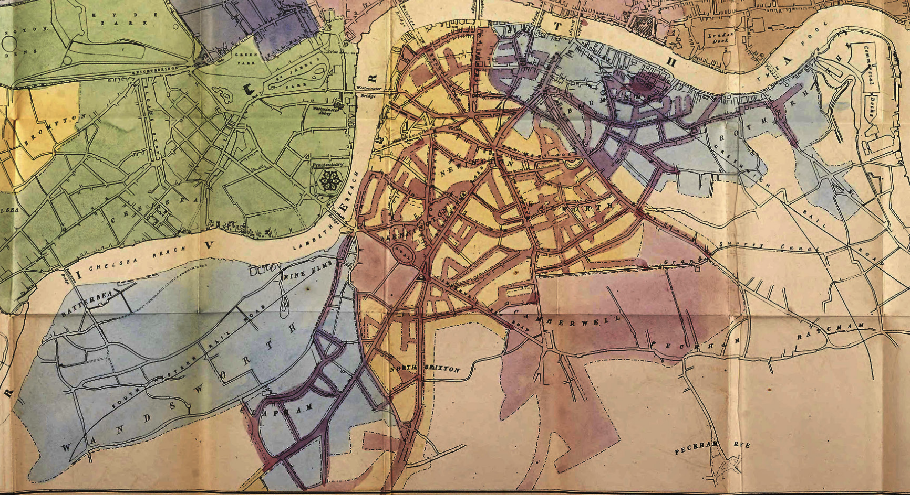
South London Water Suppliers

Slide 5
Designing Our Data Experiment
Difference in Difference

Slide 6
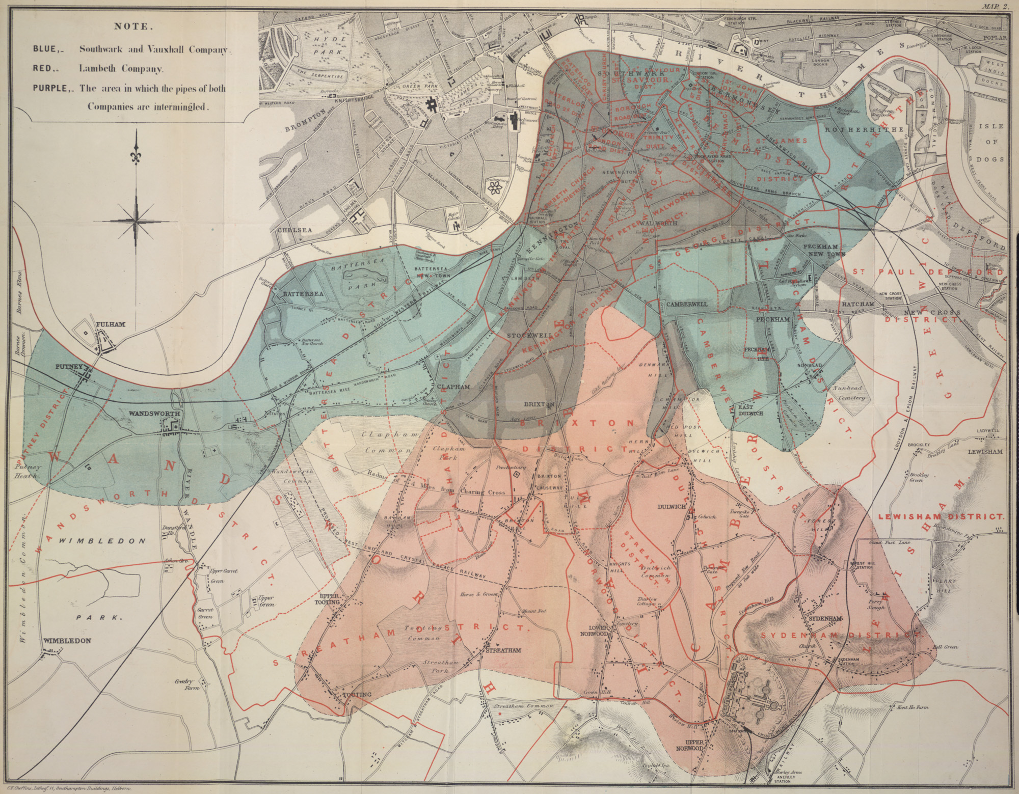
Why South London?
Both
Southwark and Vauxhall
Southwark and Vauxhall
Lambeth

Slide 7
Why South London?
Both
Cholera impacted this area of London more than others
2 water suppliers that both got their water from similar locations on the Thames River in 1849
The Lambeth company moved its water source upstream to less polluted waters in 1852
There were cholera outbreaks in 1849 and 1854
Southwark and Vauxhall
Southwark and Vauxhall
Lambeth

Slide 8
How can we think of our experiment…
Bag Toss
Treatment group: Group A (magnetic cans)
Control group: Group B (normal cans)
Explanatory variable: Type of cans (magnetic or normal)
Outcome variable: Number of cans knocked down
South London Experiment
Treatment group:
Control group:
Intervention:
Outcome variable:
Measured when before intervention:
Measured when after intervention:

Slide 9
How can we think of our experiment…
Bag Toss
Treatment group: Group A (magnetic cans)
Control group: Group B (normal cans)
Explanatory variable: Type of cans (magnetic or normal)
Outcome variable: Number of cans knocked down
South London Experiment
Treatment group: Lambeth clients
Control group:
Intervention:
Outcome variable:
Measured when before intervention:
Measured when after intervention:

Slide 10
How can we think of our experiment…
Bag Toss
Treatment group: Group A (magnetic cans)
Control group: Group B (normal cans)
Explanatory variable: Type of cans (magnetic or normal)
Outcome variable: Number of cans knocked down
South London Experiment
Treatment group: Lambeth clients
Control group: Southwark+V clients
Intervention:
Outcome variable:
Measured when before intervention:
Measured when after intervention:

Slide 11
How can we think of our experiment…
Bag Toss
Treatment group: Group A (magnetic cans)
Control group: Group B (normal cans)
Explanatory variable: Type of cans (magnetic or normal)
Outcome variable: Number of cans knocked down
South London Experiment
Treatment group: Lambeth clients
Control group: Southwark+V clients
Intervention: Water source moved
Outcome variable:
Measured when before intervention:
Measured when after intervention:

Slide 12
How can we think of our experiment…
Bag Toss
Treatment group: Group A (magnetic cans)
Control group: Group B (normal cans)
Explanatory variable: Type of cans (magnetic or normal)
Outcome variable: Number of cans knocked down
South London Experiment
Treatment group: Lambeth clients
Control group: Southwark+V clients
Intervention: Water source moved
Outcome variable: Cholera deaths
Measured when before intervention:
Measured when after intervention:

Slide 13
How can we think of our experiment…
Bag Toss
Treatment group: Group A (magnetic cans)
Control group: Group B (normal cans)
Explanatory variable: Type of cans (magnetic or normal)
Outcome variable: Number of cans knocked down
South London Experiment
Treatment group: Lambeth clients
Control group: Southwark+V clients
Intervention: Water source moved
Outcome variable: Cholera deaths
Measured when before intervention: 1849
Measured when after intervention: 1854

Slide 14
We can apply a Difference in Difference analysis to the South London Experiment!
Bag Toss
Treatment group: Group A (magnetic cans)
Control group: Group B (normal cans)
Explanatory variable: Type of cans (magnetic or normal)
Outcome variable: Number of cans knocked down
South London Experiment
Treatment group: Lambeth clients
Control group: Southwark+V clients
Intervention: Water source moved
Outcome variable: Cholera deaths
Measured when before intervention: 1849
Measured when after intervention: 1854

Slide 15
A look back at contingency tables
They allow us to compare the outcome in one group to the outcome of another group, contingent on a condition (the proposed explanation). The condition is the potential explanation.
They allow us to compare the outcome in one group to the outcome of another group, contingent on a condition (the proposed explanation). The condition is the potential explanation.
 | Southside | Northside
White Sox
Cubs

Slide 16
A look back at contingency tables
They allow us to compare the outcome in one group to the outcome of another group, contingent on a condition (the proposed explanation). The condition is the potential explanation.
 | Southside | Northside
White Sox
Cubs
Proposed explanation is that Chicago side you identify with causes you to prefer one baseball team over the other.

Slide 17
Difference in Difference (DiD)
Focuses on the change over time
Both groups start out the same and one becomes the treatment at some point during the experiment because of change related to the explanatory variable
For the bag toss game…
 | First half of game | Second half of game
Group A (magnetic cans)
Group B (normal cans)

Slide 18
Difference in Difference (DiD)
Focuses on the change in time
Both groups start out the same and one becomes the treatment at some point during the experiment because of change related to the explanatory variable
What would the DiD table look like for the South London Experiment?
 | Treatment Group | Control Group
Time Pre-Intervention
Time Post-Intervention

Slide 19
Difference in Difference (DiD)
Focuses on the change in time
Both groups start out the same and one becomes the treatment at some point during the experiment because of change related to the explanatory variable
What would the DiD table look like for the South London Experiment?
 | Mostly Lambeth (Treatment Group) | Mostly S&V (Control Group)
1849
1854

